Slide 1
Season’s Entrance Update
Proposal Pitch

Slide 2
Purpose
Save students from wasting meal swipe by seeing how busy the dining center is before entering

Slide 3
Implementation
Install card terminals
Use program to monitor students entering/exiting
Compare with the max capacity of the dining center
Display the current status in real time

Slide 4
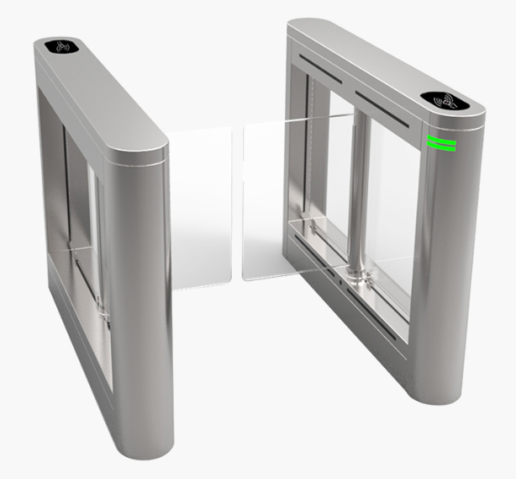
Equipment

Slide 5
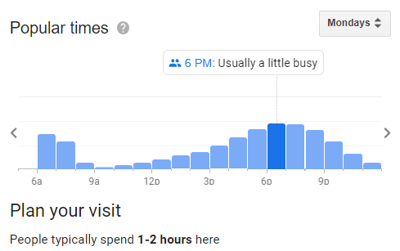
Result

